Slide 1
Texas Revolution
1821
Mexico gained independence from Spain.

Slide 2
Texas Revolution
Why the Alamo?

Slide 3
Texas Revolution
1833
Colonists in Tejas (Texans) wanted to become independent and Stephen F. Austin went to Mexico to ask for reforms. Mexico did not allow the reforms.

Slide 4
Texas Revolution
1835
Texans revolted against Mexico and formed a temporary government. Mexican claimed the Alamo was its military headquarters, but Texas fought the Mexicans and captured the Alamo.
vs.

Slide 5
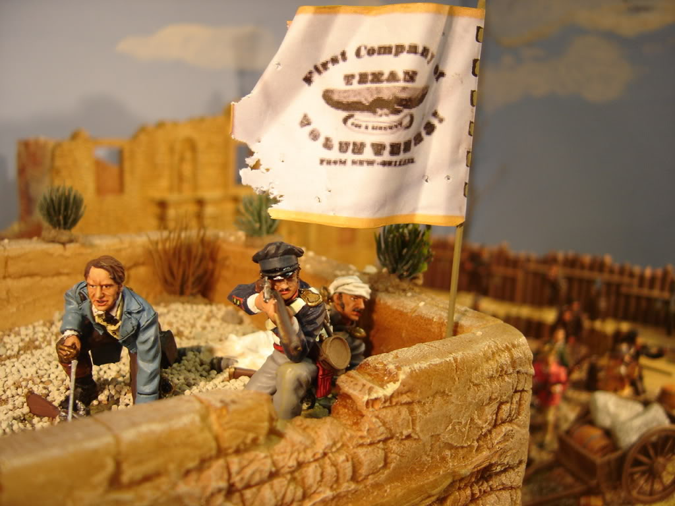
Texas Revolution
1836
January 19, 1836, James Bowie arrived to the Alamo with volunteers. Colonel William B. Travis arrived February 2nd with more soldiers. Davy Crockett and other volunteers arrived six days later.

Slide 6
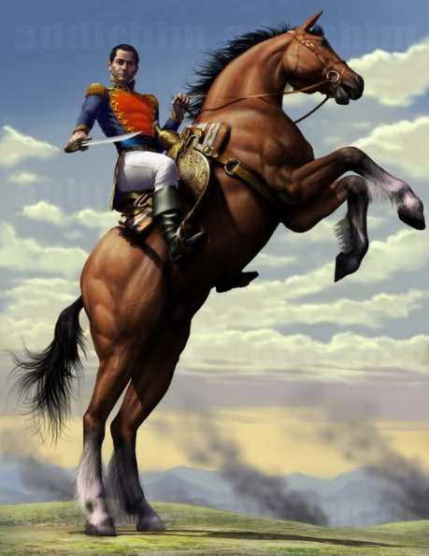
Texas Revolution
1836
Santa Anna was determined to stop the rebellion. He arrived in San Antonio on February 23, 1836 and he and his troops surrounded the Alamo.

Slide 7
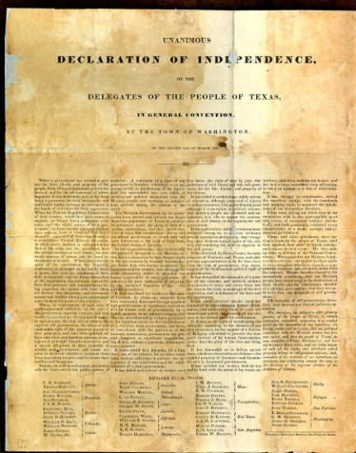
Texas Revolution
1836
March, 2 1836, Texas declared independence and the government drafted a constitution.

Slide 8
Texas Revolution
1836
Santa Anna led his men after the Texas Army. On April 20, San Jacinto River. When Santa Anna’s army took a siesta. General Sam Houston and his troops attacked, shouting “Remember the Alamo!”

Slide 9
Texas Revolution
1836
Santa Anna was captured and agreed to a treaty that would recognize Texas’s independence. On October 1836, the Republic of Texas set up a permanent government.

Slide 10
Texas Revolution
1845
December 29, 1845, Texas joined the United States as the 28th state. It was the only state that was once an independent nation.

